Slide 1
Advanced Analytics Bootcamp
Module 4: Decision Trees Learning & Development

Slide 2
Over the next 1 hour, you will get…
An overview of Decision Trees and scenarios for usage
A deep dive into Decision Trees using an example

Slide 3
Decision Trees

Slide 4
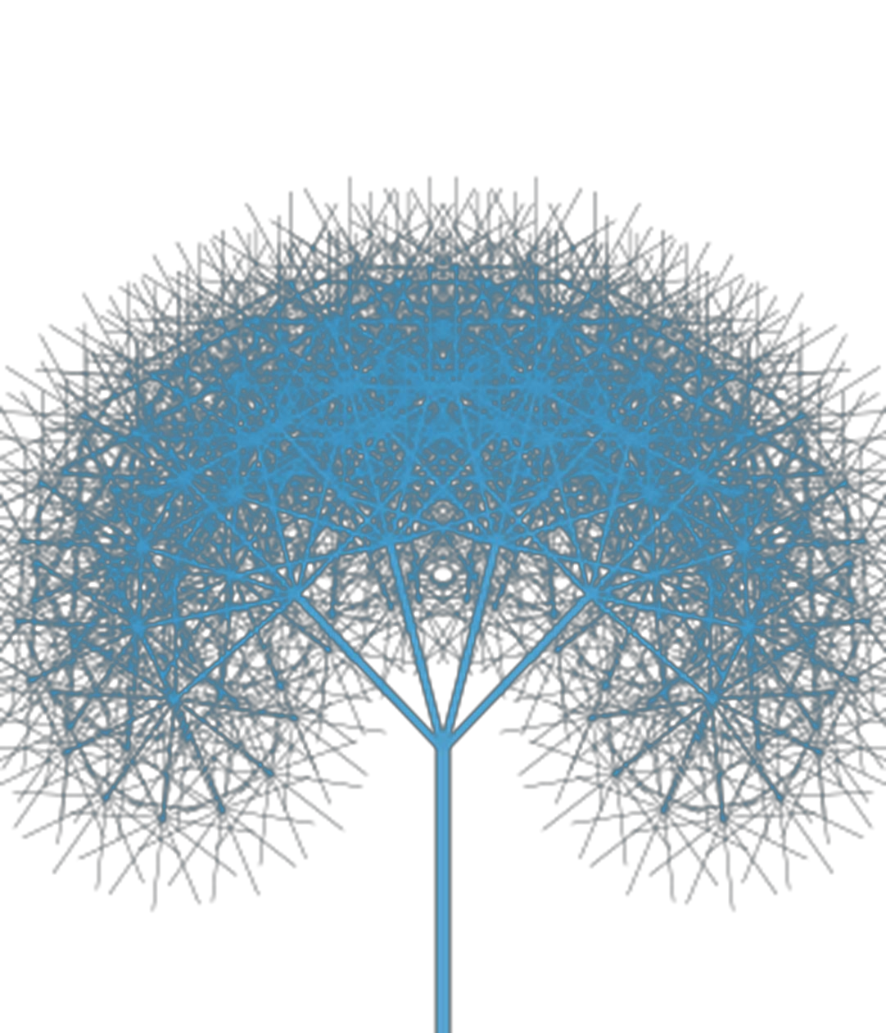
Why Decision Trees?
Why trees?
Interpretable, intuitive, popular in medical applications because they mimic the way people like to reason. Logical models.
Powerful, nonlinear

Slide 5
Decision Trees?
Example: Will the customer wait for a table at a restaurant?
OthOptions: Other options, True if there are restaurants nearby.
Weekend: This is true if it is Friday, Saturday or Sunday.
Area: Does it have a bar or other nice waiting area to wait in?
Plans: Does the customer have plans just after dinner?
Price: This is either $, $$, $$$, or $$$$
Precip: Is it raining or snowing?
Genre: French, Mexican, Thai, or Pizza
Wait: Wait time estimate: 0-5 min, 6-15 min, 16-30 min, or 30+
Crowded: Whether there are other customers (no, some, or full)

Slide 6
Example
Training Examples 14: 9 Yes and 5 No
Predict if X will Play Golf
DAY | OUTLOOK | HUMIDITY | WIND | PLAY
D1 | Sunny | High | Weak | No
D2 | Sunny | High | Strong | No
D3 | Overcast | High | Weak | Yes
D4 | Rain | High | Weak | Yes
D5 | Rain | Normal | Weak | Yes
D6 | Rain | Normal | Strong | No
D7 | Overcast | Normal | Strong | Yes
D8 | Sunny | High | Weak | No
D9 | Sunny | Normal | Weak | Yes
D10 | Rain | Normal | Weak | Yes
D11 | Sunny | Normal | Strong | Yes
D12 | Overcast | High | Strong | Yes
D13 | Overcast | Normal | Weak | Yes
D14 | Rain | High | Strong | No
Try to understand when X plays Golf
Split into subsets
Are they pure ? (all yes or all no)
If yes stop
If not repeat
New data (Today)
D15 Rain High Weak?

Slide 7
Standard Way to Build a Decision Tree
Start at the top of the tree.
Grow it by “splitting” features one by one. To split, look at how “impure” the node is
Assign leaf nodes the majority vote in the leaf
At the end, go back and prune leaves to reduce overfitting
Why is this a good way to build a tree?
Notes:
It’s not. It’s really what I call a hack. But it works really well. I have to warn you that C4.5 and CART are not elegant by any means that I
can dene elegant. But the resulting trees can be very elegant. Plus there are
2 of the top 10 algorithms in data mining that are decision tree algorithms! So
it's worth it for us to know what's under the hood... even though, well... let's
just say it ain't pretty.

Slide 8
Outlook
Example (1/4)
9 yes and 5 No
Sunny
Overcast
Rain
Day | Outlook | Humidity | Wind | Play
D1 | Sunny | High | Weak | No
D2 | Sunny | High | Strong | No
D8 | Sunny | High | Weak | No
D9 | Sunny | Normal | Weak | Yes
D11 | Sunny | Normal | Strong | Yes
Day | Outlook | Humidity | Wind | Play
D3 | Overcast | High | Weak | Yes
D7 | Overcast | Normal | Strong | Yes
D12 | Overcast | High | Strong | Yes
D13 | Overcast | Normal | Weak | Yes
Day | Outlook | Humidity | Wind | Play
D4 | Rain | High | Weak | Yes
D5 | Rain | Normal | Weak | Yes
D6 | Rain | Normal | Strong | No
D10 | Rain | Normal | Weak | Yes
D14 | Rain | High | Strong | No
2 yes and 3 No
4 yes and 0 No
3 yes and 2 No
Split further
Pure Subset
Split further

Slide 9
Outlook
Example (2/4)
9 yes and 5 No
Sunny
Overcast
Rain
Day | Outlook | Humidity | Wind | Play
D3 | Overcast | High | Weak | Yes
D7 | Overcast | Normal | Strong | Yes
D12 | Overcast | High | Strong | Yes
D13 | Overcast | Normal | Weak | Yes
Day | Outlook | Humidity | Wind | Play
D4 | Rain | High | Weak | Yes
D5 | Rain | Normal | Weak | Yes
D6 | Rain | Normal | Strong | No
D10 | Rain | Normal | Weak | Yes
D14 | Rain | High | Strong | No
Humidity
High
Normal
4 yes and 0 No
Day | Wind | Play
D1 | Weak | No
D2 | Strong | No
D8 | Weak | No
Day | Wind | Play
D9 | Weak | Yes
D11 | Strong | Yes
Pure Subset
3 yes and 2 No
Split further
Pure Subset
Pure Subset

Slide 10
Outlook
Example (3/4)
9 yes and 5 No
Rain
Sunny
Overcast
Day | Outlook | Humidity | Wind | Play
D3 | Overcast | High | Weak | Yes
D7 | Overcast | Normal | Strong | Yes
D12 | Overcast | High | Strong | Yes
D13 | Overcast | Normal | Weak | Yes
Wind
Humidity
High
Normal
Weak
Strong
Day | Wind | Play
D1 | Weak | No
D2 | Strong | No
D8 | Weak | No
4 yes and 0 No
Day | Humidity | Play
D4 | High | Yes
D5 | Normal | Yes
D10 | Normal | Yes
Day | Humidity | Play
D6 | Normal | No
D14 | High | No
Day | Wind | Play
D9 | Weak | Yes
D11 | Strong | Yes
Pure Subset
Pure Subset
Pure Subset
Pure Subset
Pure Subset

Slide 11
Outlook
Example (4/4)
9 / 5
Rain
3 / 2
Sunny
2 / 3
4 / 0
Overcast
Wind
Humidity
Yes
3 / 0
0 / 2
0 / 3
2 / 0
Weak
Strong
High
Normal
Yes
No
No
Yes
Which attribute to split on?
A Logical formula which says if X will play
D15 | Rain | Weak | YES

Slide 12
Which attribute to split on?
Outlook
9 / 5
Wind
9 / 5
Sunny
Overcast
Rain
Weak
Strong
2 / 3
4 / 0
3 / 2
6 / 2
3 / 3
Measure the purity of split
Entropy , a measure of the uncertainty is used to find the best attribute to split on

Slide 13

You learnt so far…
Decision trees are powerful, non linear but logical models that mimics the way people like to reason
The standard way to build a decision tree is by “splitting” features one by one
At the end, it is important to go back and prune the tree to limit its size and avoid overfitting

